Slide 1
String in C
Md. Alamgir Hossain
Senior Lecturer,
Dept. of CSE, Prime University
Mail: alamgir.cse14.just@gmail.com

Slide 2

String in C
The string can be defined as the one-dimensional array of characters terminated by a null (‘\0’).
The character array or the string is used to manipulate text such as word or sentences. Each character in the array occupies one byte of memory, and the last character must always be 0.
The termination character (‘\0’) is important in a string since it is the only way to identify where the string ends. When we define a string as char s[10], the character s[10] is implicitly initialized with the null in the memory.

Slide 3
Ways to Declare a String in C
There are two ways to declare a string in c language. 1. By char array, 2. By string literal
Example of declaring string by char array in C:
While declaring string, size is not mandatory. So we can write the above code as given below:

Slide 4

Ways to Declare a String in C
We can also define the string by the string literal in C. For example:
In such case, ‘\0’ will be appended at the end of the string by the compiler.

Slide 5
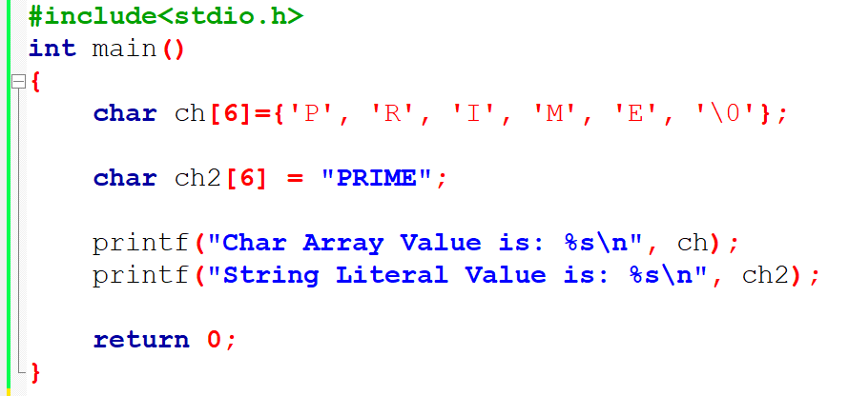
Printing Example

Slide 6
Traversing String
Traversing the string is one of the most important aspects in any of the programming languages.
Traversing string is somewhat different from the traversing an integer array. We need to know the length of the array to traverse an integer array, whereas we may use the null character in the case of string to identify the end the string and terminate the loop.
There are two ways to traverse a string. 1. By using the length of string, 2. By using the null character.

Slide 7
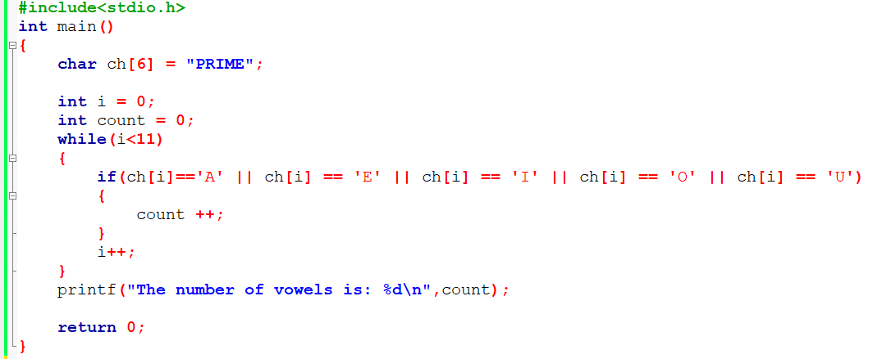
Traversing Using the Length of String

Slide 8
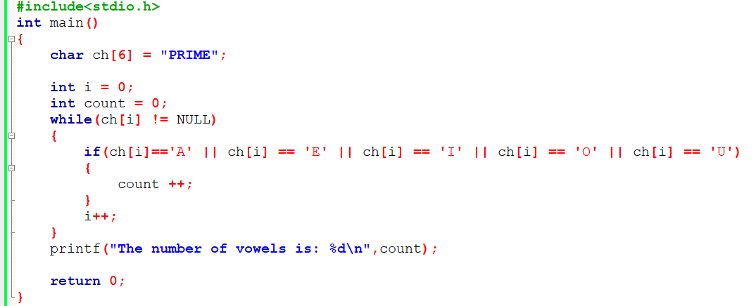
Traversing Using the Null Character

Slide 9
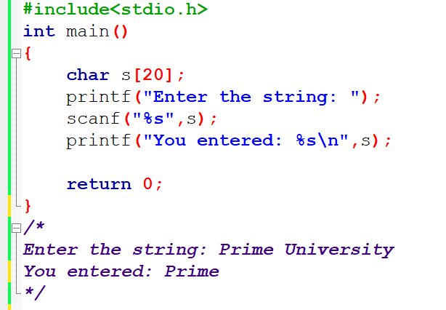
Accepting String as the Input
The below code will not work for space separated strings.

Slide 10
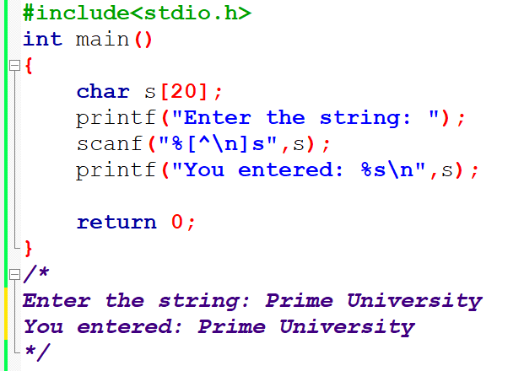
Accepting String as the Input
We must also notice that we do not need to use address of (&) operator in scanf to store a string since string s is an array of characters and the name of the array, i.e., s indicates the base address of the string (character array) therefore we need not use & with it.

Slide 11
Some Important Points
The compiler doesn’t perform bounds checking on the character array. Hence, there can be a case where the length of the string can exceed the dimension of the character array which may always overwrite some important data.
Instead of using scanf, we may use gets() which is an inbuilt function defined in a header file string.h. The gets() is capable of receiving only one string at a time.

Slide 12
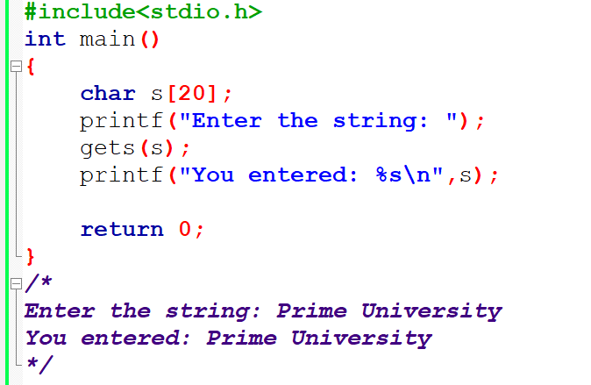
C gets() and puts() Functions
The gets() function enables the user to enter some characters followed by the enter key. All the characters entered by the user get stored in a character array. The null character is added to the array to make it a string. The gets() allows the user to enter the space-separated strings. It returns the string entered by the user.

Slide 13
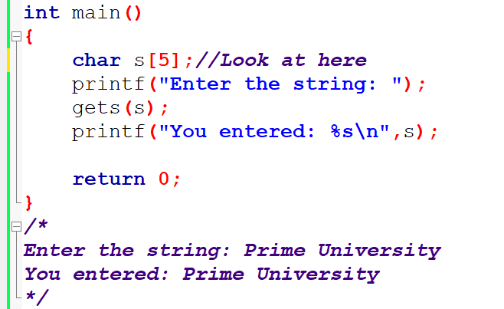
C gets() and puts() Functions
The gets() function is risky to use since it doesn’t perform any array bound checking and keep reading the characters until the new line (enter) is encountered. It suffers from buffer overflow,

Slide 14
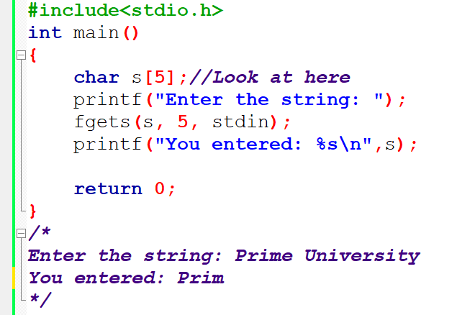
C gets() and puts() Functions
Which can be avoided by using fgets(). The fgets() makes sure that not more than the maximum limit of characters are read. Consider the following example.

Slide 15
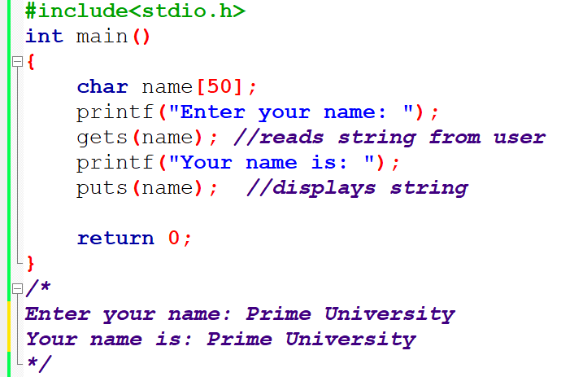
C gets() and puts() Functions
The puts() function is very much similar to printf() function. The puts() function is used to print the string on the console which is previously read by using gets() or scanf() function.

Slide 16
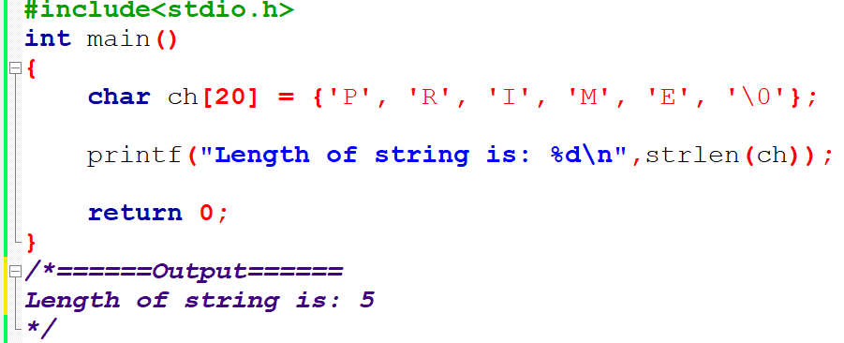
C String Functions:: strlen()
The strlen() function returns the length of the given string. It doesn’t count null character ‘\0’.

Slide 17
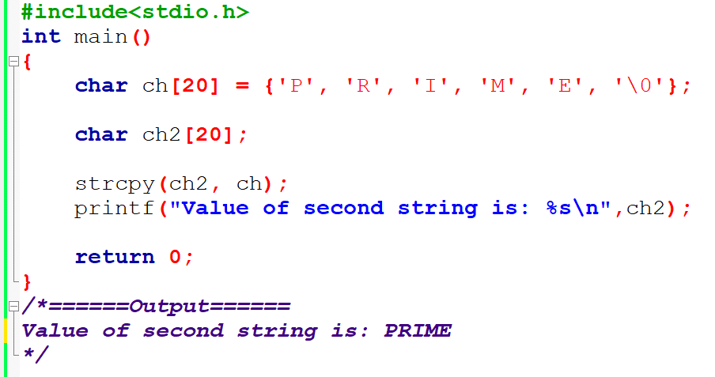
C String Functions:: strcpy()
The strcpy(destination, source) function copies the source string in destination.

Slide 18
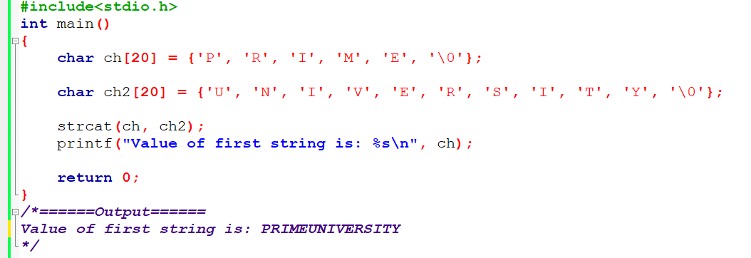
C String Functions:: strcat()
The strcat(first_string, second_string) function concatenates two strings and result is returned to first_string.

Slide 19
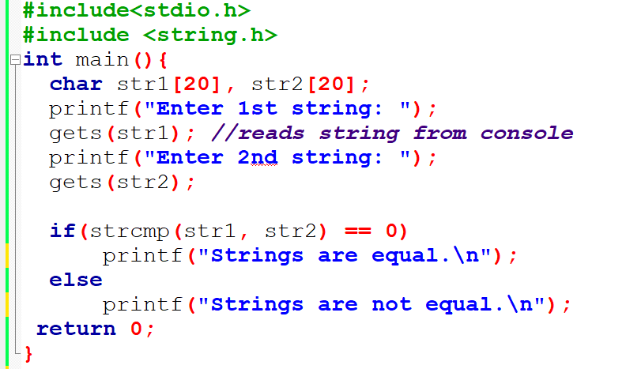
C String Functions:: strcmp()
The strcmp(first_string, second_string) function compares two string and returns 0 if both strings are equal.

Slide 20
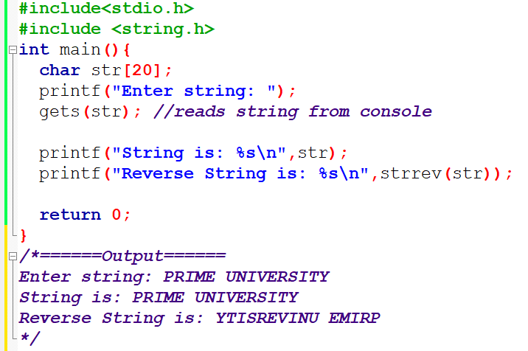
C String Functions:: strrev()
The strrev(string) function returns reverse of the given string. Let’s see a simple example of strrev() function.

Slide 21
C String Functions:: strlwr(), strupr()
The strlwr(string) function returns string characters in lowercase.
The strupr(string) function returns string characters in uppercase.

Slide 22
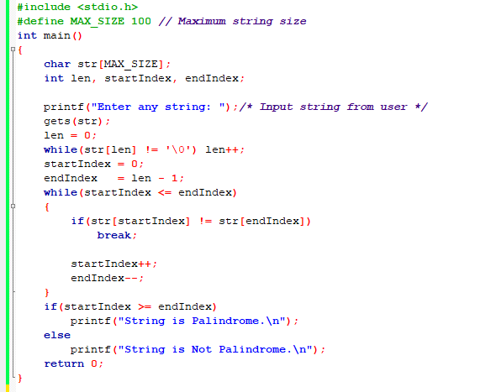
C program to check whether a string is palindrome or not

Slide 23
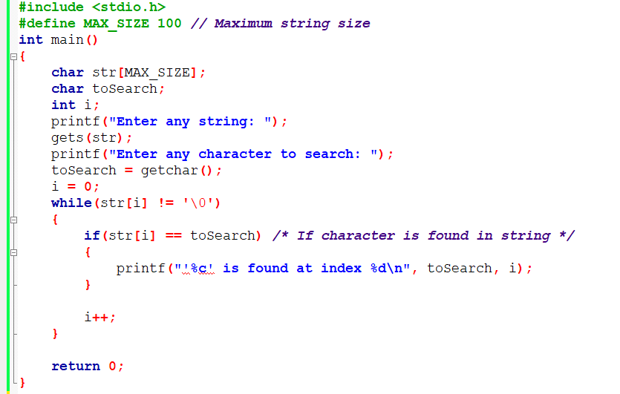
C program to search all occurrences of a character in a string

Slide 24
Homework
Write a C program to search all occurrences of a word in given string.
Input string: I love programming. I love Prime University.
Input word to search: love
‘love’ is found at index: 2
‘love’ is found at index: 22
Write a C program to find maximum occurring character in a string.
Input string: I love Pime University.
Maximum occurring character: ‘ ’

Slide 25
Thank You

